Slide 1
Inheritance in C++
Nilanjana G. Basu, HIT, Kolkata

Slide 2
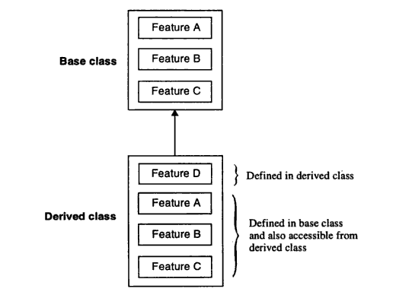
Base and Derived class

Slide 3
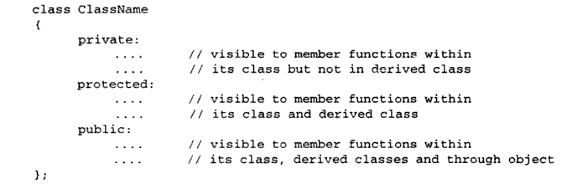
Access specifiers

Slide 4
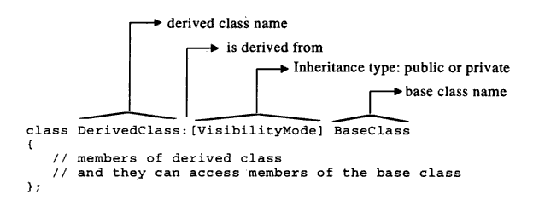
Syntax

Slide 5
Syntax
class base{}
class sub:public base
class sub:protected base
class sub:private base
class sub: base// default-private

Slide 6
private inheritance
Base Class
Derived Class
Private
(not accessible)
Private
Protected
Protected
Public
Public
protected inheritance
Base Class
Derived Class
Private
(not accessible)
Private
Protected
Protected
Public
Public

Slide 7
public inheritance
Base Class
Derived Class
Private
(not accessible)
Private
Protected
Protected
Public
Public

Slide 8
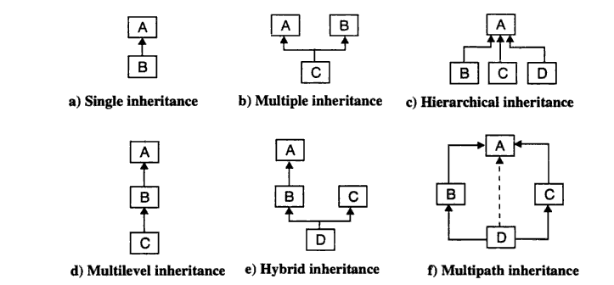
Types of Inheritance

Slide 9
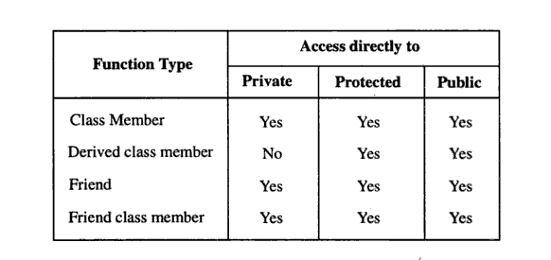
Accessibility to different functions

Slide 10
Order of constructor call in Single Inheritance
class A{
public: A(){cout<<"no argument constructor of base class"<<endl;};
A(int y){cout<<"one argument constructor of base class"<<endl;};
};
class B: public A{
public: B(){cout<<"no argument constructor of derived class"<<endl;};
//B(int x){cout<<"one argument constructor of derived class"<<endl;}; // call the no argument constructor of base class
B(int x):A(x){cout<<"one argument constructor of derived class"<<endl;};
};
int main(){
B obj;
B obj2(10);
}

Slide 11
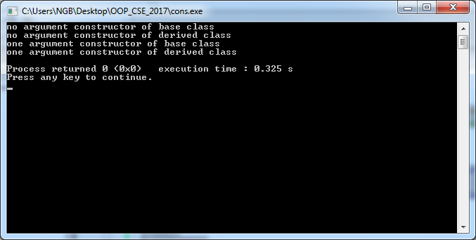
Output

Slide 12
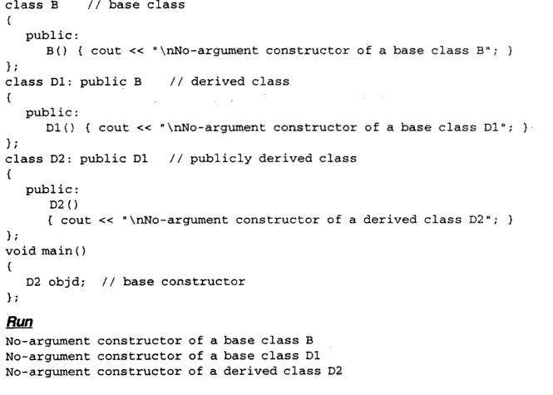
Order of constructor and destructor call in Multi level Inheritance

Slide 13
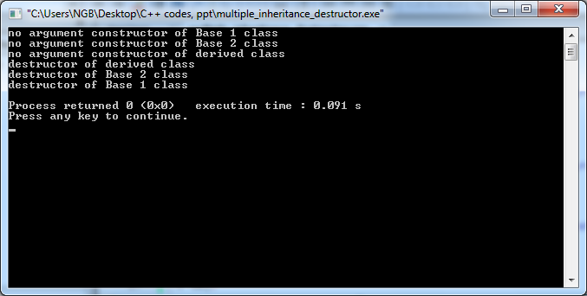
Output

Slide 14
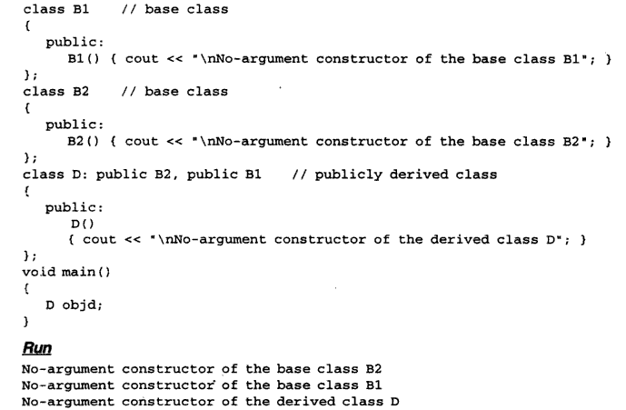
Order of constructor call in Multiple Inheritance

Slide 15
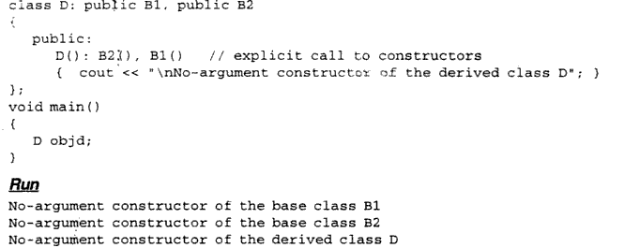
Order of constructor call in Multiple Inheritance(2)

Slide 16
Destructor call in multiple inheritance
class A{
public: A(){cout<<"no argument constructor of Base 1 class"<<endl;};
~A(){cout<<"destructor of base class"<<endl;};
};
class B{
public: B(){cout<<"no argument constructor of Base 2 class"<<endl;};
~B(){cout<<"destructor of Base 2class"<<endl;};
};
class C:public A,B{
public: C(){cout<<"no argument constructor of derived class"<<endl;};
~C(){cout<<"destructor of derived class"<<endl;};
};
int main(){
C obj;
}

Slide 17
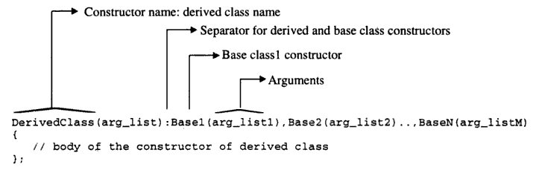
Syntax to call parameterized constructor of Base classes

Slide 18
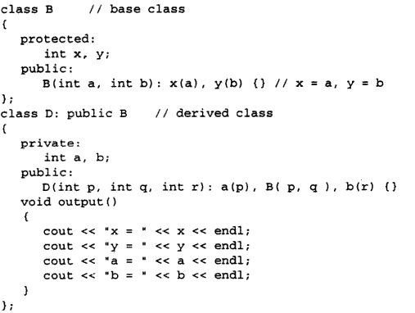
Example Program

Slide 19
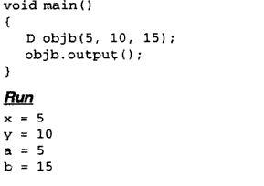
Output

Slide 20
Erroneous examples
class B{
protected: int c;
public: B(int z):c(z){}
void show(){cout<<c<<endl;}
};
class C:public B{
int d,e;
public: C(int p):d(p),e(d*2),B(p){} //if d(e),e(p*2),B(p)/d(p),e(p),B(d)
void show(){B::show();
cout<<d<<" " <<e<<endl;}
};

Slide 21
Contd…
int main(){
C obj2(10);
obj2.show();
}

Slide 22
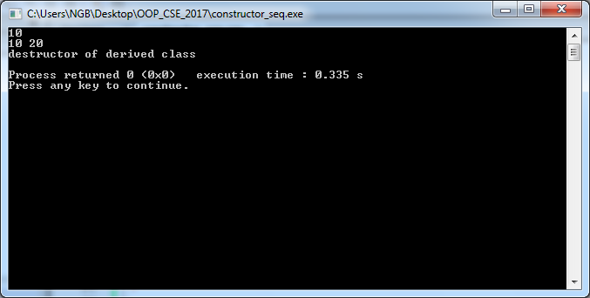
Output

Slide 23
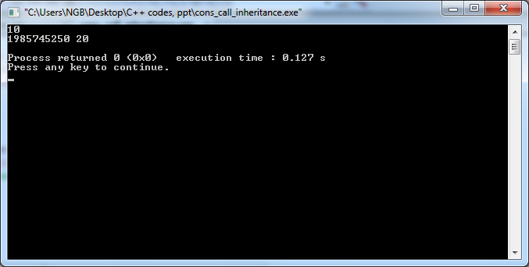
Erroneous output

Slide 24
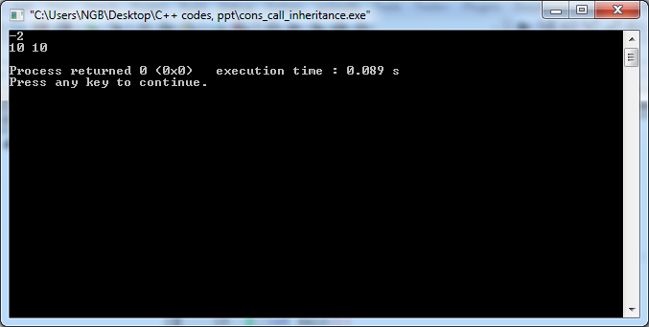
Erroneous output

Slide 25
:: operator in multiple inheritance
class B{
protected: int c;
public: B(int z):c(z){}
void show(){cout<<"Inside B"<<endl;cout<<c<<endl;}
};
class C{
protected: int c;
public: C(int z):c(z){}
void show(){ cout<<"Inside C"<<endl;
cout<<c<<endl;}
};
class D:public B,public C{
public: D(int p):B(p), C(2*p){}
void show(){ cout<<"Inside D"<<endl;
B::show();}
};

Slide 26
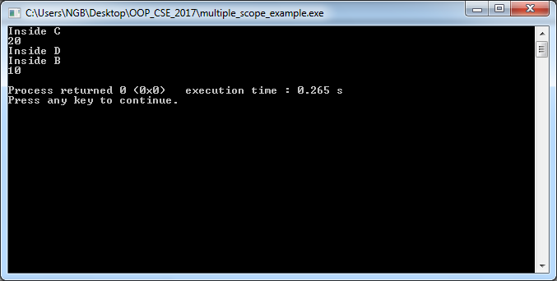
Output
int main(){
D obj(10);
obj.C::show();
obj.show();}

Slide 27
Multipath Inheritance
class B{
protected: int b;
public: B(int z):b(z){}
void show(){cout<<"Inside B"<<endl;cout<<b<<endl;}
};
class C:public B{
protected: int c;
public: C(int z):c(z),B(z*2){}
};
class D:public B{
protected: int d;
public: D(int z):d(z),B(z*3){}
};
class E:public C, public D{
protected: int e;
public: E(int z):e(z),C(z*2), D(z*3){}
};
int main(){
E obj(10);
obj.show();
}

Slide 28
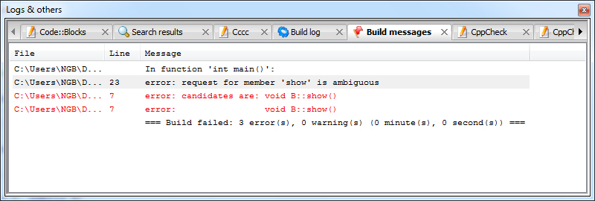
Compiler error

Slide 29
Corrected Program
#include<iostream>
using namespace std;
class B{
protected: int b;
public: B(int z):b(z){cout<<"Inside B"<<endl;cout<<b<<endl;}
void show(){cout<<"Inside B's show()"<<endl;cout<<b<<endl;}
};
class C:public virtual B{
protected: int c;
public: C(int z):c(z),B(z*2){cout<<"Inside C"<<endl;cout<<b<<endl;}
};
class D:virtual public B{
protected: int d;
public: D(int z):d(z),B(z*3){cout<<"Inside D"<<endl;cout<<b<<endl;}
};

Slide 30
Contd..
class E:public C, public D{
protected: int e;
public: E(int z):e(z),B(z*4),C(z*2), D(z*3){cout<<"Inside E"<<endl;cout<<b<<endl;}
};
int main(){
E obj(10);
obj.show();
}

Slide 31
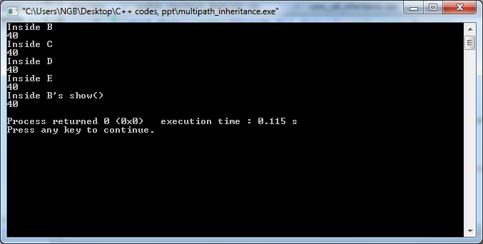
Output

Slide 32
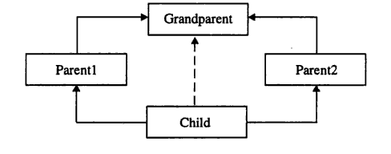
virtual base class
Grandparent is the virtual base class of Child and all the subclasses of Child
Grandparent is the direct base class of Parent1 and Parent2
Parent1 and Parent2 are direct base classes of Child

Slide 33
Destructor call of multipath inheritance
class B{
protected: int b;
public: B(int z):b(z){cout<<"Inside B's constructor"<<endl;}
void show(){cout<<"Inside B"<<endl;cout<<b<<endl;}
~B(){cout<<"Inside B's destructor"<<endl;}
};
class C:virtual public B{
protected: int c;
public: C(int z):c(z),B(z*2){cout<<"Inside C's constructor"<<endl;}
~C(){cout<<"Inside C's destructor"<<endl;}
};
class D:public virtual B{
protected: int d;
public: D(int z):d(z),B(z*3){cout<<"Inside D's constructor"<<endl;}
~D(){cout<<"Inside D's destructor"<<endl;}
};

Slide 34
Contd..
class E:public C, public D{
protected: int e;
public: E(int z):e(z),C(z*2), D(z*3),B(z*4){cout<<"Inside E's constructor"<<endl;}
~E(){cout<<"Inside E's destructor"<<endl;}
};
int main(){
E obj(10);
obj.show();
}

Slide 35
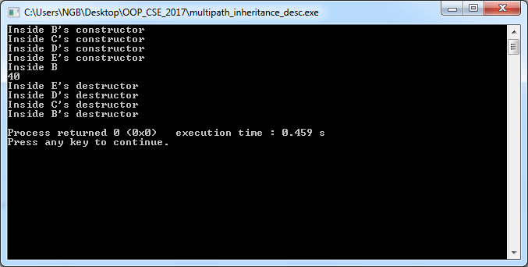
Output

Slide 36
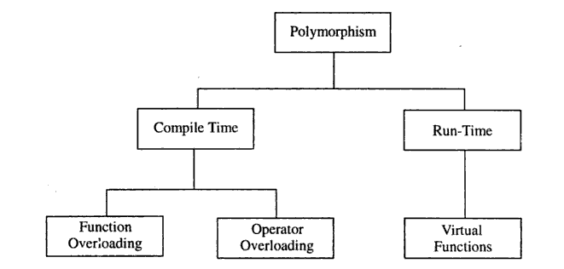
Polymorphism in C++

Slide 37
Virtual function
#include<iostream>
using namespace std;
class heritage_student{
protected:
string name;
public:heritage_student(string a):name(a){}
void show(){cout<<name<<endl;}
};
class heritage_cse_student:public heritage_student{
string name_cse;
public:heritage_cse_student(string a,string b):heritage_student(a),name_cse(b){}
void show(){cout<<name_cse<<endl;}
};

Slide 38
Contd..
int main(){
heritage_student obj("Heritage");
obj.show();
heritage_cse_student obj2("Heritage","ABC");
obj2.show();
obj=obj2;obj.show();
}

Slide 39
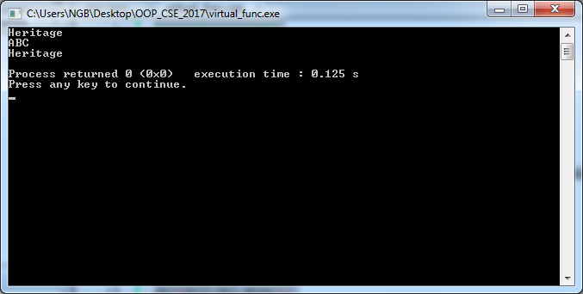
Output

Slide 40
Another way
int main(){
heritage_student *obj;
heritage_cse_student obj2("Heritage","ABC");
obj=&obj2;obj->show();
}

Slide 41
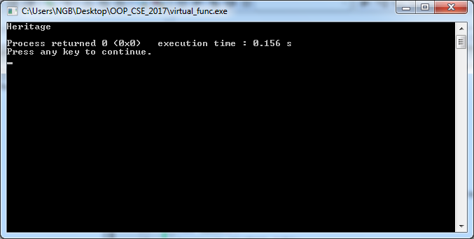
output

Slide 42
Properly done program
class heritage_student{
protected:
string name;
public:heritage_student(string a):name(a){}
virtual void show(){cout<<name<<endl;}
};
class heritage_cse_student:public heritage_student{
string name_cse;
public:heritage_cse_student(string a,string b):heritage_student(a),name_cse(b){}
void show(){cout<<name_cse<<endl;}
};
int main(){
heritage_student *obj;
heritage_cse_student obj2("Heritage","ABC");
obj=&obj2;obj->show();
}

Slide 43
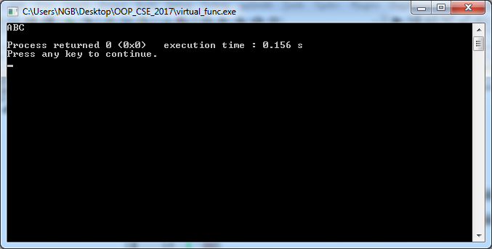
Output

Slide 44
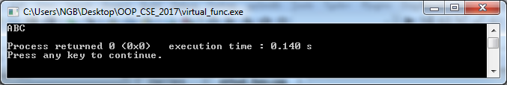
int main(){
heritage_student *obj=new heritage_cse_student("Heritage","ABC");
obj->show();
}

Slide 45
Virtual destructor
class heritage_student{
protected:
string name;
public:heritage_student(string a):name(a){}
virtual void show(){cout<<name<<endl;}
~heritage_student(){cout<<"base destructor"<<endl;}
};
class heritage_cse_student:public heritage_student{
string name_cse;
public:heritage_cse_student(string a,string b):heritage_student(a),name_cse(b){}
void show(){cout<<name_cse<<endl;}
~heritage_cse_student(){cout<<"derived destructor"<<endl;}
};

Slide 46
Contd..
int main(){
heritage_student *obj=new heritage_cse_student("Heritage","ABC");
obj->show();
delete obj;
}

Slide 47
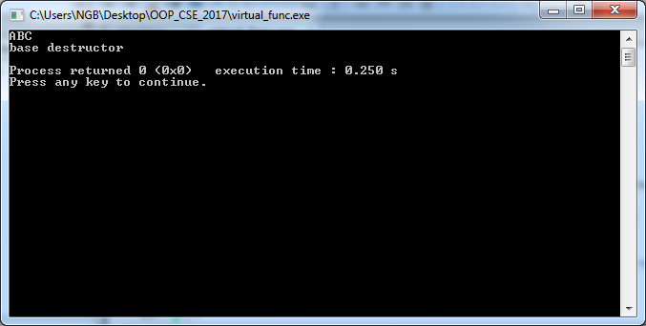
Output

Slide 48
Corrected Program
class heritage_student{
protected:
string name;
public:heritage_student(string a):name(a){}
virtual void show(){cout<<name<<endl;}
virtual ~heritage_student(){cout<<"base destructor"<<endl;}
};

Slide 49
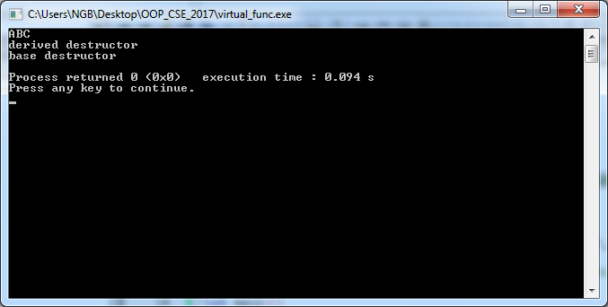
output

Slide 50
pure virtual function(abstract method in C++)
class heritage_student{
protected:
string name;
public:heritage_student(string a):name(a){}
virtual void show()=0;
virtual ~heritage_student(){cout<<"base destructor"<<endl;}
};
class heritage_cse_student:public heritage_student{
string name_cse;
public:heritage_cse_student(string a,string b):heritage_student(a),name_cse(b){}
void show(){cout<<name<<endl; cout<<name_cse<<endl;}
~heritage_cse_student(){cout<<"derived destructor"<<endl;}
};

Slide 51
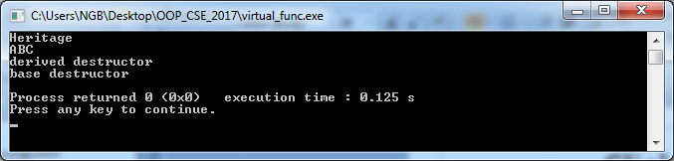
Contd..
int main(){
heritage_student *obj=new heritage_cse_student("Heritage","ABC");
obj->show();
}

Slide 52
Another example
class shape{
protected:
int dim1,dim2;
public:
shape(int x, int y):dim1(x),dim2(y){}
virtual void area()=0;
};
class rectangle:public shape{
public:
rectangle(int x, int y):shape(x,y){}
void area(){cout<<dim1*dim2<<endl;}
};
class square:public shape{
public:
square(int x):shape(x,x){}
void area(){cout<<dim1*dim2<<endl;}
};

Slide 53
Contd..
int main(){
shape *ptr;
ptr=new rectangle(2,3);
ptr->area();
ptr=new square(4);
ptr->area();
delete ptr;
return 0;
}

Slide 54
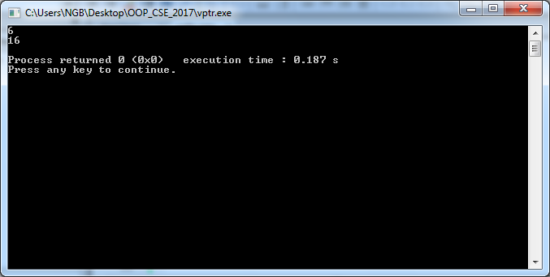
Output

Slide 55
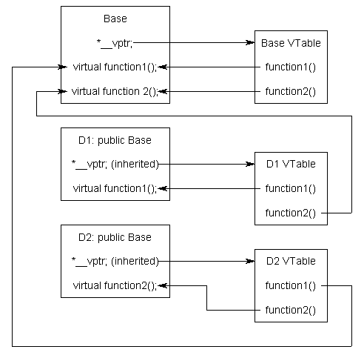
vtable and vptr

Slide 56
override annotation
The override keyword serves two purposes:
It shows the reader of the code that "this is a virtual method, that is overriding a virtual method of the base class.“
The compiler also knows that it's an override, so it can "check" that you are not altering/adding new methods that you think are overrides.

Slide 57
Program 1
#include<iostream>
using namespace std;
class A{
public:
virtual void show(){cout<<"Inside A"<<endl;}
};
class B:public A{
public:
void show() override{cout<<"Inside B"<<endl;}// Gives no error, Prints Inside B
//void show(int a)override {cout<<"Inside B"<<endl;} //Gives error, marked override, but does not override
//void sho() override{cout<<"Inside B"<<endl;} //Gives error, marked override, but does not override
};

Slide 58
Example Program
int main(){
B obj;obj.show();// It is not using polymorphic behaviour
A * ptr=new B; //It is using polymorphic behaviour
ptr->show();
// Both are example of overriding.
}

Slide 59
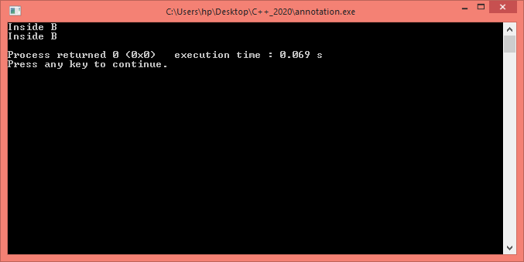
output

